Slide 1

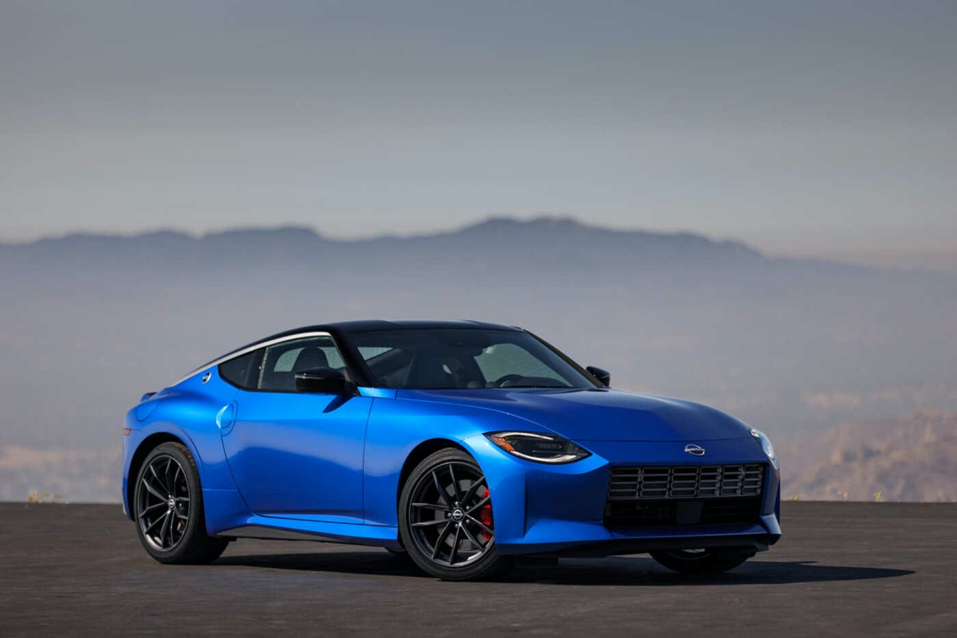
Used Car Price Prediction Project
Created By
Jayashri Dandare

Slide 2
Introduction

Slide 3
Business Problem Framing
With the covid 19 impact in the market, we have seen lot of changes in the car market. Now some cars are in demand hence making them costly and some are not in demand hence cheaper. One of our clients works with small traders, who sell used cars. With the change in market due to covid 19 impact, our client is facing problems with their previous car price valuation machine learning models. So, they are looking for new machine learning models from new data. We have to make car price valuation model.
The pre-owned vehicle market is a developing business with a market esteem that has almost multiplied itself in earlier years. The ascent of online sites and other instruments like it has made it more straightforward for the two purchasers and merchants to improve comprehension of the variables that decide the market worth of a preowned vehicle. In light of a set of variables, Machine Learning calculations might be used to conjecture the cost of any vehicle. The informational collection will remember data for an assortment of vehicles. There will be data with respect to the vehicle's specialized components, for example, the motor kind, fuel type, total driven kilometres, and that's only the tip of the iceberg, for each vehicle.

Slide 4
Data Collection
We have scraped the data for over 5000 cars using Selenium script from 4 different websites from different different locations around the country. The websites are as followed:
https://www.olx.in/
https://www.cardekho.com/
https://www.cars24.com/
https://autoportal.com/

Slide 5
Description for Dataset
'Brand & Model' : It gives us the brand of the car along with its model name and manufacturing year
'Varient' : It gives us the varient of particular car model
'Fuel Type' : It gives us the type of fuel used by the car
'Driven Kilometers' : It gives us the total distance in kms covered by car
'Transmission' : It tells us whether the gear transmission is Manual or Automatic
'Owner' : It tells us the total numbers of owners car had previously
'Location' : It gives us the location of the car
'Date of Posting Ad' : It tells us when the advertisement for selling that car was posted online
'Price (in ₹)' : It gives us the price of the car.
In the above dataset the target is to predict the 'Price' of car.

Slide 6
Exploratory Data Analysis (EDA) Steps
Data Visualization
Statistical summary
To check Correlation
Univariate Analysis
Bivariate Analysis

Slide 7
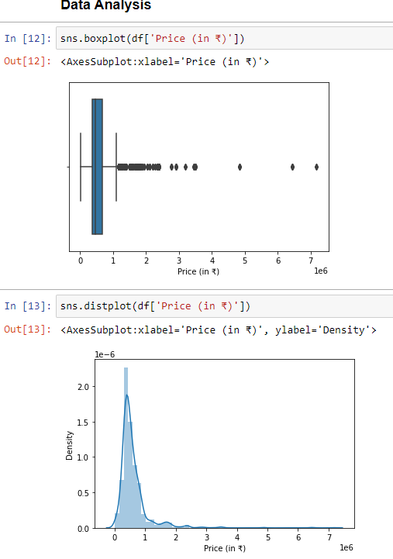
Data Visualization
We have plotted histograms and distribution plot in univariate analysis, which interpreted that all the columns are equally important but the columns like brand, variant, location, date and total driven kilometres have a wide range of data spread hence we will not perform its bivariate analysis.

Slide 8
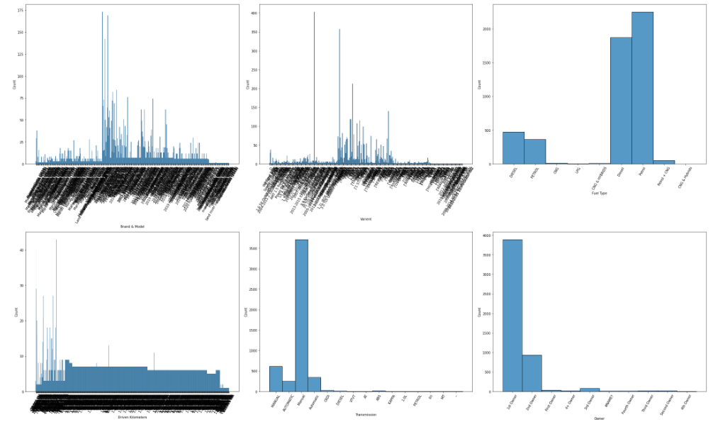
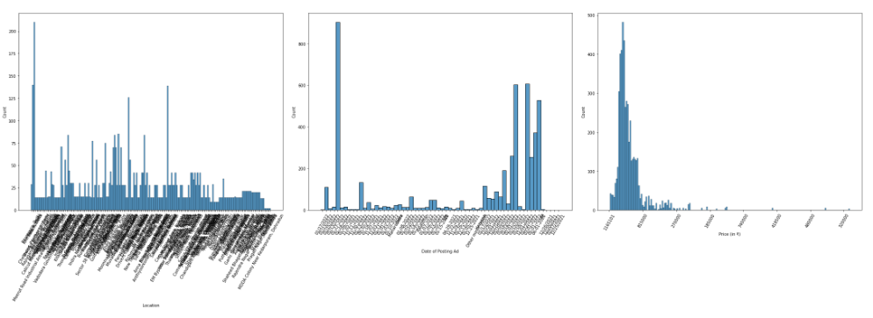
Brands, Varients, Driven Kilometres & Location have a wide range of values in them.
Maximum Cars run on either Petrol or diesel. Only few goes for CNG and other fuels.
Maximum Cars have Manual transmission.
Maximum cars are being sold by their very 1st Owner.
We have collected the cars posted online in last one month, from 25th December 2021 to 27th January 2022.
Almost all the cars have a price ranging in between 270000 to 1165101.

Slide 9
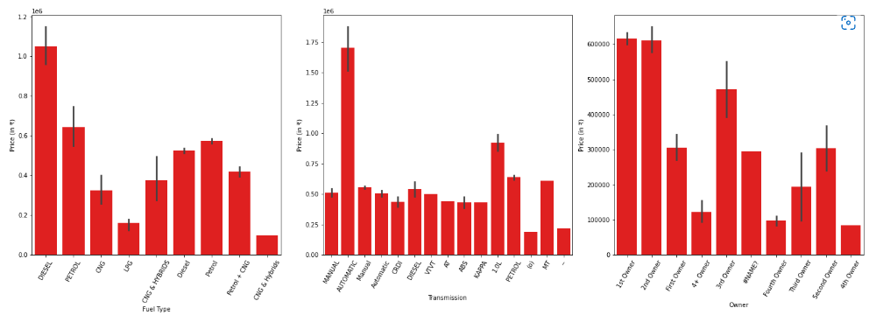
From bivariate analysis we conclude that, Since Brands, Varients, Driven Kilometers & Location have a wide range of values in them, we will not perform bivariate analysis for them as they will not give us any specific details. Now by plotting graph of Fuel type, Transmission and Owner against Price, we conclude that Car that uses Diesel, have automatic Transmission and Has only 1 owner is more likely to have a high price.

Slide 10
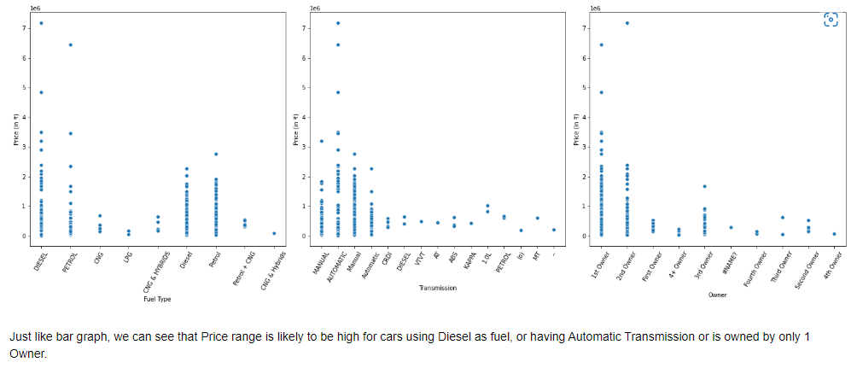

Slide 11
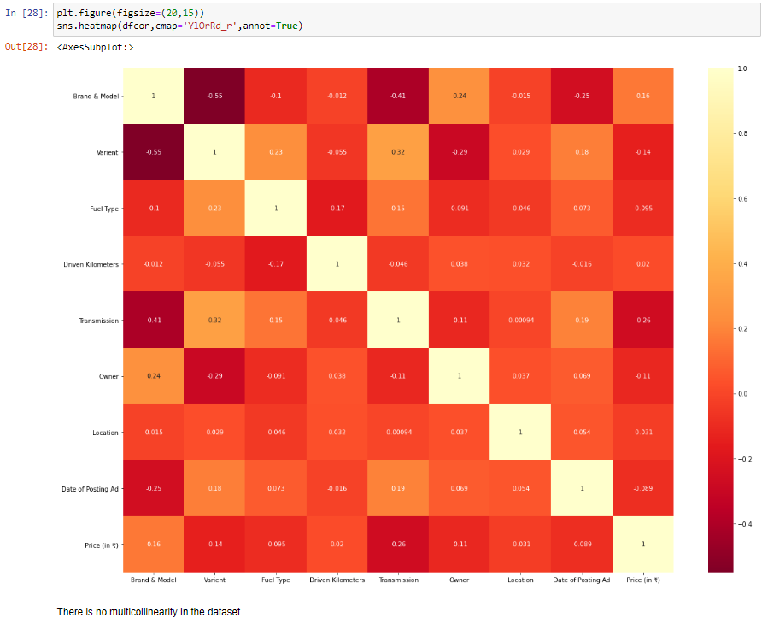
Heatmap

Slide 12
Machine Learning Model for Regression
The models used training and testing datasets are as followed:
SVR
Linear Regression
SGD Regressor
KNeighbors Regressor
Decision Tree Regressor
Random Forest Regressor
Only Decision Tree Regressor and Random Forest Regressor are performing well and giving accuracy of 80.2 % and 87.7% , respectively.

Slide 13
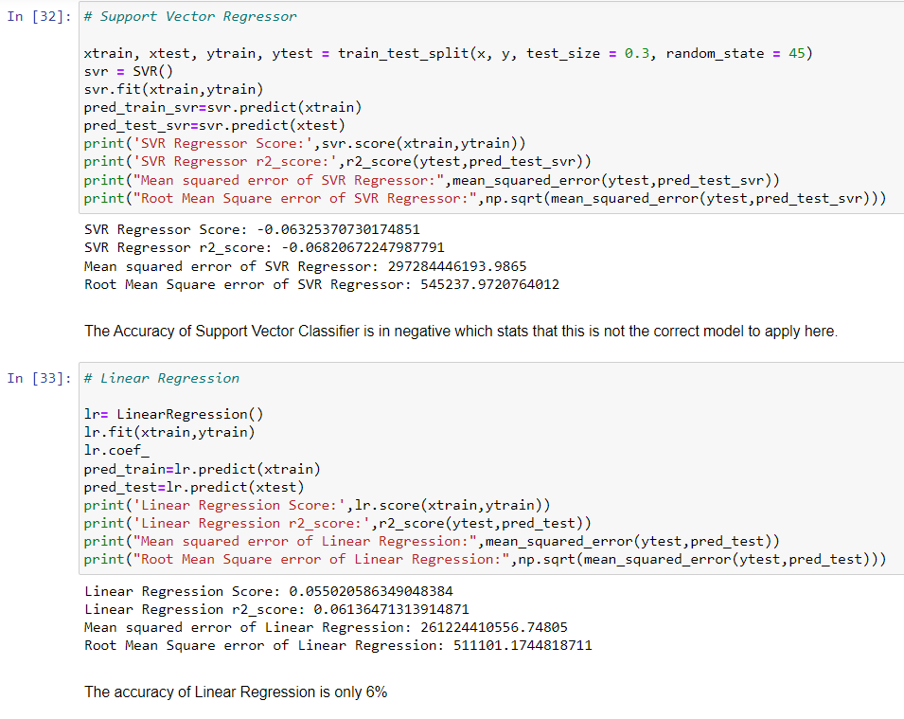

Slide 14
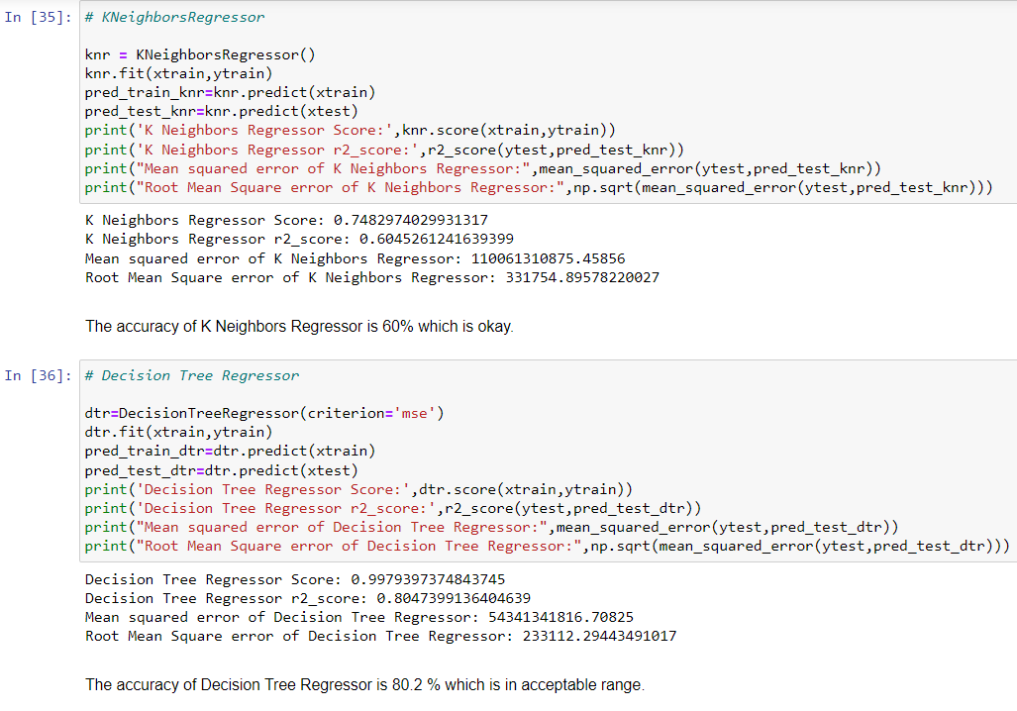

Slide 15
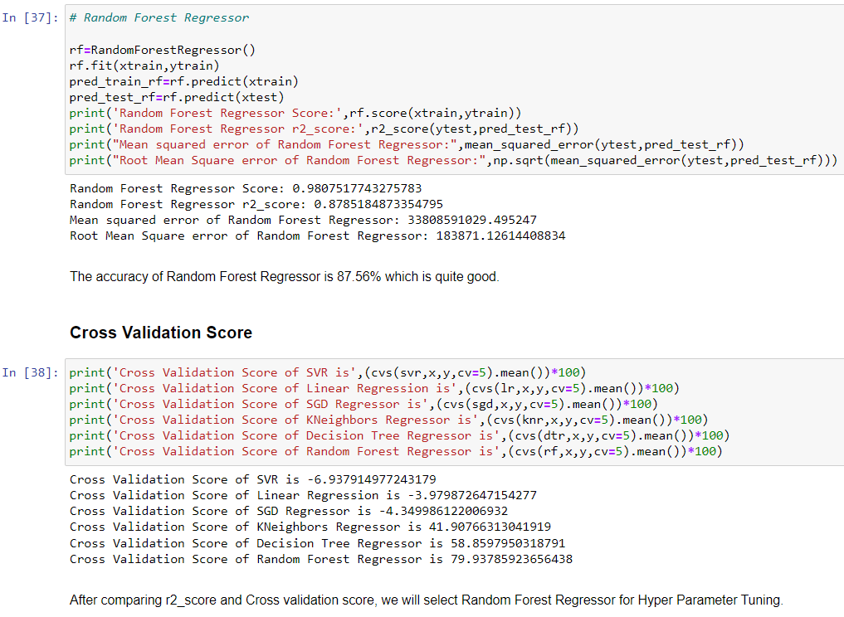

Slide 16
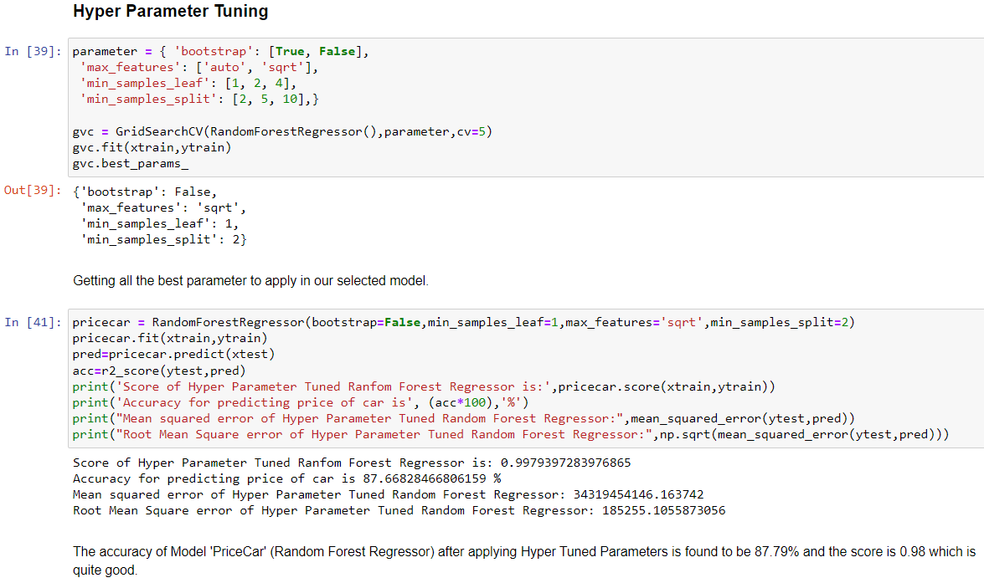
Interpretation of the Results

Slide 17
Conclusion

Slide 18
Key Findings and Conclusions of the Study
Car price prediction has picked researchers' interest since it takes a significant amount of work and expertise on the part of the field expert. For a dependable and accurate forecast, a large number of unique attributes are analysed. We employed 6 different machine learning approaches to develop a model for forecasting the price of used automobiles. The respective performances of different algorithms were then compared to discover the one that best suited the existing data set.
The final prediction model was implemented in a python programme. Furthermore, the model was tested with test data, yielding an accuracy of 87.76 percent.

Slide 19
Learning Outcomes of the Study in respect of Data Science
Using well-known algorithms from Python libraries, we were able to successfully construct machine learning algorithmic paradigms. On our dataset, we first do pre-processing and data cleaning.
We trimmed the tuples that contained null values, which accounted for less than 1% of the total. The findings revealed a positive relationship between price and kilometres travelled, as well as year of registration and kilometres travelled.
Negative correlation is related to the notion of inverse proportion, whereas positive correlation is related to the concept of direct proportion. The model was trained using over 5000 tuples.

Slide 20
Limitations of this work and Scope for Future Work
As a part of future work, we aim at the variable choices over the algorithms that were used in the project. We could only explore two algorithms whereas many other algorithms which exist and might be more accurate. More specifications will be added in a system or providing more accuracy in terms of price in the system i.e.
1) Horsepower
2) Battery power
3) Suspension
4) Cylinder
5) Torque

Slide 21
Thank You

